Slide 1
“I, too” by Langston Hughes
Yesterday we turned in our rewritten conclusions for “Hills Like White Elephants” and we turned in some Compound Sentences. Make sure you have both of those submitted.
Today, you’ll need paper for notes, title that paper “Harlem Renaissance”
On those notes, read this poem and answer the following questions:
Note the title, what is it significance to the poem itself?
Who is the speaker?
What does Hughes mean when the speaker "sings America"?
Who is speaker "singing" to?
What is the significance of the tone change from "I, too, sing America" to "I, too, am America"?
I, too, sing America.
I am the darker brother.
They send me to eat in the kitchen
When company comes,
But I laugh,
And eat well,
And grow strong.
Tomorrow,
I’ll be at the table
When company comes.
Nobody’ll dare
Say to me,
“Eat in the kitchen,”
Then.
Besides,
They’ll see how beautiful I am
And be ashamed—
I, too, am America

Slide 2
Harlem Renaissance
1920s – 1940s
Harlem, New York City

Slide 3
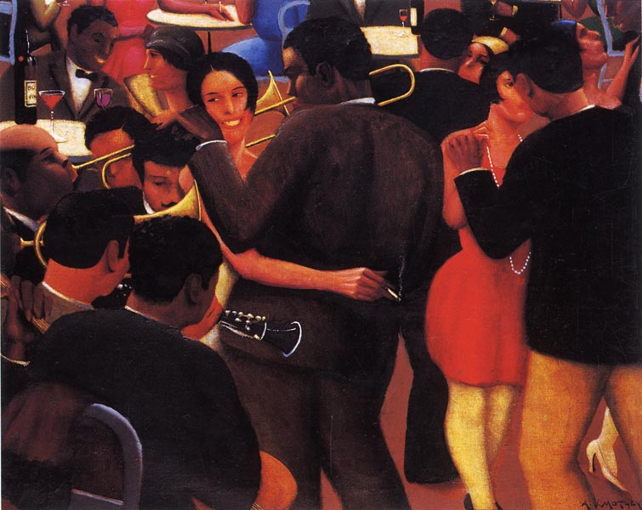
What It Was
A flowering of African American art, literature, music and culture in the United States led primarily by the African American community based in Harlem, New York City.

Slide 4
Overview
ren·ais·sance
A rebirth or revival
A revival of intellectual or artistic achievement and vigor
French, from Old French, from renaistre, to be born again
Source: The American Heritage® Dictionary of the English Language, Fourth Edition Copyright © 2000 by Houghton Mifflin Company.
Notes:
http://www.pbs.org/newshour/forum/february98/harlem_2-20.html
http://dictionary.reference.com/search?q=renaissance

Slide 5
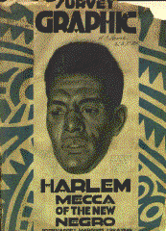
Harlem Renaissance
an outpouring of creative expression that had long been bottled up by the constraints of segregation.
originally called the New Negro Movement.
fostered a new black cultural identity.
1920s through mid-40s.
Notes:
http://www.levity.com/corduroy/harlem.htm

Slide 6
The Great Migration
At the beginning of the period, particularly in the South, racism was rampant, and economic opportunities were scarce.
At this time in the South, African Americans were restricted to "colored" facilities clearly inferior to those reserved for white citizens.
Lynching was used to instill fear in entire African American communities in the South.

Slide 7
Causes of Migration
new farm machinery drove thousands of tenant farmers off the land.
1915 - severe boll weevil infestation
Southern states had fewer schools and higher rates of illiteracy than Northern states.
Northern states also had more cultural attractions and booming industries.

Slide 8
Boom Time?
The years between World War I and the Great Depression were "boom times" in the United States.
A "boom" is a time of rapid, widespread expansion of economic opportunity, during which jobs are plentiful.
Jobs were plentiful in cities, especially in the North.

Slide 9
Why Leave the South?
Between 1920 and 1930, almost 750,000 African Americans left the South for political, social, and economic reasons.
Why go North?
wider opportunities for prosperity
more racially tolerant environments
a sense of actual (as opposed to theoretical) citizenship
Mass exodus from the South called The Great Migration.

Slide 10
Children in the Silent Protest Parade, 1917 Page from The Brownies Book, published by NAACP
Notes:
http://www.si.umich.edu/CHICO/Harlem/text/children_slide.html
On July 28, 1917, in New York City, a silent parade was staged in protest of the East St. Louis, Illinois, massacre of July 2, 1917, as well as the recent lynchings in Waco, Texas, and Memphis, Tennessee. The march was organized by the NAACP, churchmen and other civic leaders to protest the violent events against African Americans around the country. The United States had just entered World War I and many were questioning the use of African-American soldiers to fight in a war that President Woodrow Wilson had described as necessary to the survival of democracy abroad, especially at a time when these same men and their families were denied their basic rights here in the United States. President Wilson continually dismissed the requests of African-American leadership to address the problem of lynching and was considered by many to be one of the most racist presidents ever to occupy the White House. The lynching and murdering of blacks was on the rise. And in the wartime climate many African Americans were migrating to the North, both to escape racial oppression in the South and to secure the plentiful jobs in the munitions centers and factories in the Northern urban centers.
The riots in East St. Louis began when whites, angry because African Americans were employed by a factory holding government contracts, went on a rampage. Over $400,000 worth of property was destroyed. At least 40 African Americans were killed. Men, women and children were beaten, stabbed, hanged and burned. Nearly 6,000 African Americans were driven from their homes.
Across the country, people were aghast at the violence. On July 28, 8,000 African Americans, primarily from Harlem, marched silently down Fifth Avenue. They were dressed in their finest clothes and marched to the sound of muffled drums. They carried picket signs while thousands of New Yorkers watched from the sidewalks. The children marched as well as the adults. Some of the banners read: "Mother, do lynchers go to heaven?" "Mr. President, why not make America safe for democracy?" "Thou shalt not kill." "Pray for the Lady Macbeths of East St. Louis." "Give us a Chance to Live."
The New York Age reported on the march:
They marched without uttering one word or making a single gesticulation and protested in respectful silence against the reign of mob law, segregation, "Jim Crowism" and many other indignities to which the race is unnecessarily subjected in the United States. (1917)
Lynching was never declared a felony by the judicial system of the United States.
http://www.si.umich.edu/CHICO/Harlem/text/silentprotest.html

Slide 11
Reaction of White Southerners
Promised better pay and improved treatment.
Intimidation
Some even boarded northbound trains to attack African American men and women in an attempt to return them forcibly to their homes.

Slide 12
The New Negro Has no Fear
After centuries of abuse in the South, many African Americans were "voting with their feet"
UNIA Parade Organized in Harlem, 1924
Notes:
http://www.si.umich.edu/CHICO/Harlem/text/unia.html

Slide 13
The North: Home Sweet Home?
The North was a step up from the South, but it was no paradise.
Segregation in housing and hiring were the norm.
Northern racism sometimes took on a brutality that equaled anything in the South.

Slide 14
The North: Home Sweet Home?
New arrivals could land only low-paying jobs as janitors, elevator operators, domestics, and unskilled laborers.
Despite the challenges, most of those who went North never returned.

Slide 15
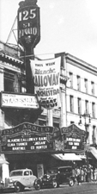
Why "Harlem" Renaissance?
Of the almost 750,000 African Americans who moved North, nearly 175,000 moved to Harlem.
Harlem is a section of Manhattan, which covers three square miles; therefore, Harlem became the largest concentration of black people in the world.
Notes:
http://www.chipublib.org/001hwlc/litlists/harlemren.html

Slide 16
Triggers of Harlem Renaissance
the end of World War I and the return of black veterans
the formation of civil rights organizations (NAACP) and black solidarity movements (UNIA)
the ascendance of Harlem as the "Negro capital of the world"
a new sense of economic, social, and cultural potential
Notes:
Marcus Garvey's Universal Negro Improvement Association - UNIA

Slide 17
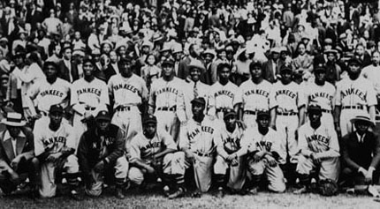
New York Black Yankees, 1939 Photo credit: Morgan & Marvin Smith
Notes:
http://www.si.umich.edu/CHICO/Harlem/text/nybyankees.html

Slide 18
Lafayette Theatre opening night of Shakespeare's "Macbeth"
also known as the "House Beautiful“
probably the first New York theater to desegregate
as early as 1912, African-American theatergoers were allowed to sit in orchestra seats instead of only the balcony.
Notes:
http://www.si.umich.edu/CHICO/Harlem/text/lafayette.html

Slide 19
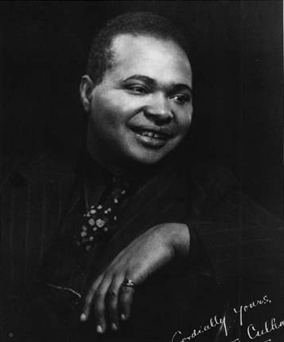
Authors and Works
Creative expression was one of the few avenues available to African Americans
Common bond: They dealt with African American life from an African American perspective.
African-American-owned magazines and newspapers flourished
Countee Cullen (1903-1946) poet, novelist, playwright
Notes:
http://www.si.umich.edu/CHICO/Harlem/text/cullen_slide.html

Slide 20
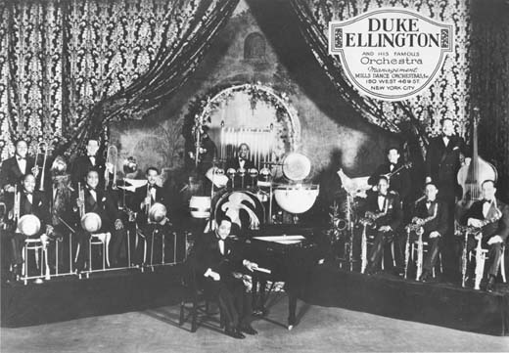
Edward Kennedy (Duke) Ellington (1899-1974) composer, musician, band leader
Notes:
http://www.si.umich.edu/CHICO/Harlem/text/ellington_slide.html

Slide 21
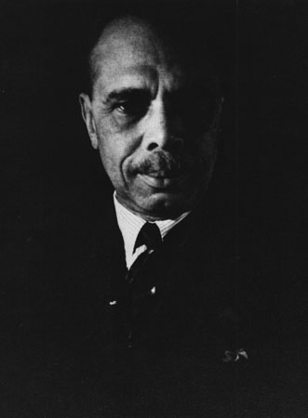
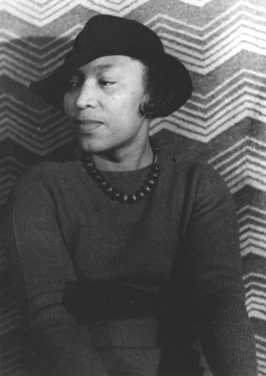
Zora Neal Hurston (1891 - 1960)
Writer, Folklorist, Anthropologist photo by Carl Van Vechten
James Weldon Johnson (1871-1938) writer, poet, statesman
Notes:
http://www.si.umich.edu/CHICO/Harlem/text/jwjohnson_slide.html
http://www.si.umich.edu/CHICO/Harlem/text/hurston.html

Slide 22
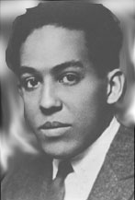
Famous Faces of the Harlem Renaissance
Langston Hughes (1902-1967)
“Dreams”
“Harlem”
“The Weary Blues”
Notes:
http://www.nku.edu/~diesmanj/hughes.html

Slide 23
Beginning:
1924 Opportunity magazine hosted a party for black writers with many white publishers attending
Also known as the ”New Negro Movement”
Ending:
1929, the year of the stock market crash and the resulting economic Great Depression.

Slide 24
Literary Themes
Alienation/ Marginality
Twoness/Double Consciousness
Jazz

Slide 25
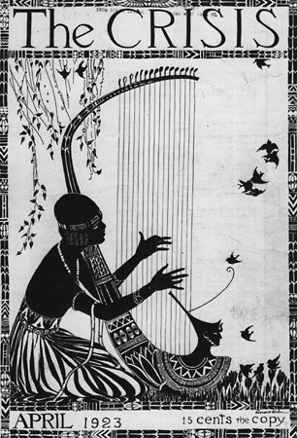
Through all these themes Harlem Renaissance writers were determined to express the African-American experience in all its variety and complexity as realistically as possible.

